Slide 1

Ian Kresyman | Nabil Ettachfini | Krishna Chaitanya Kodur | Prashanth Thipparthi | Blake Galbavy

Slide 2
WatchDogs is a web-based analytical tool developed to help visualize the relationship between stock activity and market sentiment using Twitter data.

Slide 3









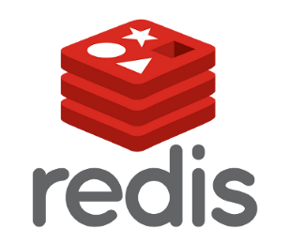



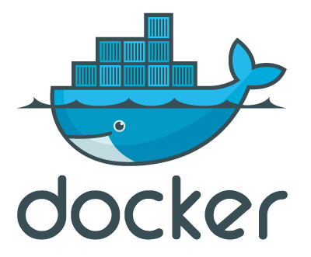

Slide 4
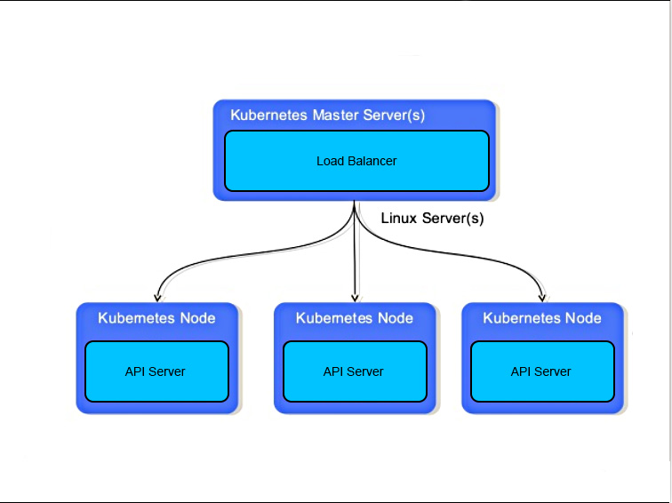

Google Cloud Platform
Cloud Computing Service, all servers running in GCP
Personal Docker Storage
Kubernetes Cluster

Slide 5




Spark/Kafka
Pulling Tweets from Twitter API using tweepy
Pushing into the Kafka Broker
Spark Reads from Kafka → Computes Sentiment of the Tweets using the text blob and pushes the required information of tweets into a different topic of kafka
twitter
databases

Slide 6
Choice of which sentiment analysis library to use
Vader Sentiment
Less accurate
Less configurable
Much slower than other ML models
Textblob
IBM Watson
Requires API keys
More complicated to integrate with python
Can only determine positive and negative sentiment, not neutral
Easy to integrate
More optimizable
Uses NLTK and pattern.en
Accuracy vs speed balanced

Slide 7

MongoDB
Persistent Database which stores temporal data, tweets and sentiment
Used to populate the redis cache if the cache server restarts
Notes:
Mongo DB is the persistent storage for this project. It stores Date, Time, Sentiment Value ranging from -1 to 1, Text of the tweet, Latitude, and Longitude from where the tweet was tweeted. We also have a redis cache which updates itself from Mongo DB.

Slide 8



RedisJSON
In memory data structure store used as a database and cache
Different from Redis in some aspects
Full support of JSON
Provision to add elements at certain path
The main purpose of using RedisJSON in place of Redis
Used as cache for REST API servers
all the GET requests are cached with new data
GET requests are processed very fast.
Notes:
The cache database we have used here is RedisJSON which is slightly different from original Redis. Unlike Redis, RedisJSON fully supports JSON format, hence it is very apt for REST API servers which usually give output in JSON format. It also allows adding elements at a certain path which is a major advantage for our project. We add new incoming tweets to mongo as well as Redis so that API calls are faster. Addition of redis drastically improved the load time of API from minutes to seconds.

Slide 9

Docker/Kubernetes
Big data tools run in dockers and deployed to kubernetes.
Load Balancer
Used to load balance the three instances of API server
Keep the IP address constant during updating the K8 clusters
Notes:
All the services used in the project are implemented in docker which are subsequently deployed to kubernetes. There are 3 instances of REST API servers which are load balanced by kubernetes. Load balancing also ensures that the IP is constant even after deleting and recreating the deployments. I am also running a database populator pod for pulling the tweets from Kafka and pushing them to Mongo and Redis. I just wanted “fail fast, auto restart” feature of Apache Storm which was easily provided to me by kubernetes. Hence docker and kubernetes have a central role in the backend.

Slide 10



Travis And Kubernetes
Travis is used as primary CI and CD tool.
The created docker images are stored in a private google cloud container registry
During deployment, kubernetes fetches the latest image with tag latest and deploys them.
Everything is fully automated CI & CD pipeline
After every build, Travis sends a slack notification to the groups' slack channel as a reminder.
Notes:
Travis was used as a Continuous Integration and continuous deployment tool. I wrote yaml scripts which automated all the building process. We built docker images for each micro-service and those docker images were pushed to Private google container registry. These docker images are built out of a customized python alpine image necessary for the project. This accelerated the build time. After every build, a slack notification was sent indicating the status of the build.

Slide 11
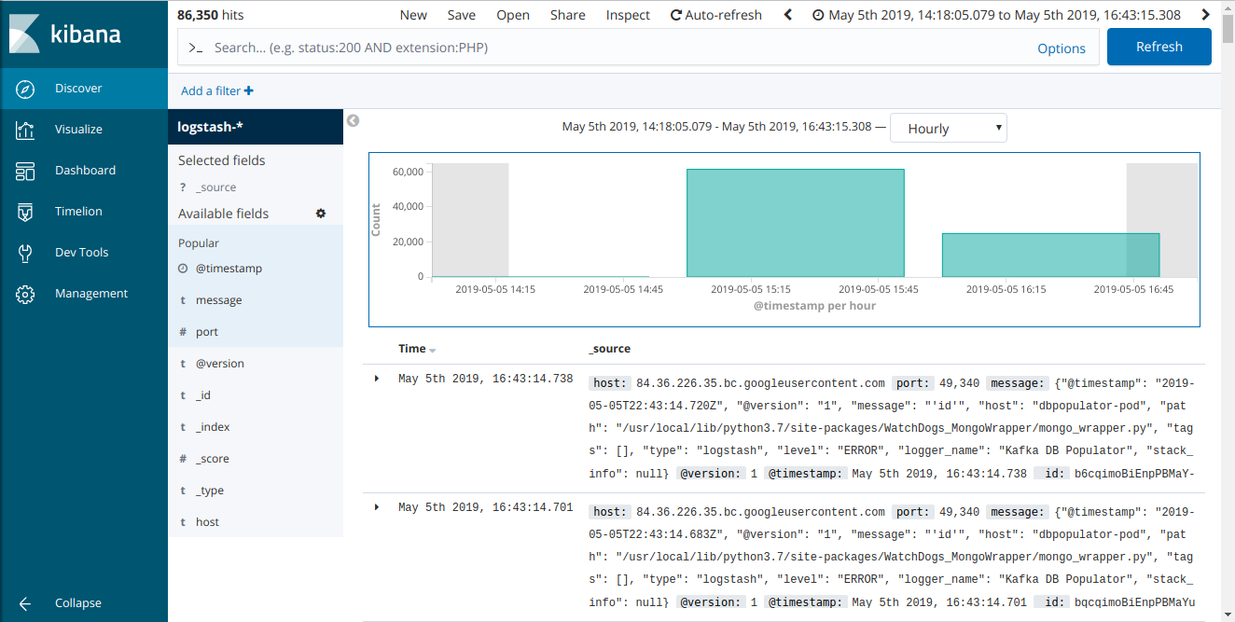
Kibana Dashboard
Centralized Log Collection using Logstash, filtering them using elastic search and visualizing them using Kibana
Notes:
To debug the application, getting logs in a timely fashion is very important. For this, I used ELK (Elastic Search, Logstash, Kibana) stack. The elastic search was useful in filtering the logs. Kibana was used to visualize the logs. Logstash collected the logs from individual applications through port 5000. If the density of bars increases, then that means an exception has occurred and it needs to be addressed. The kibana dashboard was instrumental in debugging the applications and finding out the origin of the error and fixing them in time.

Slide 12
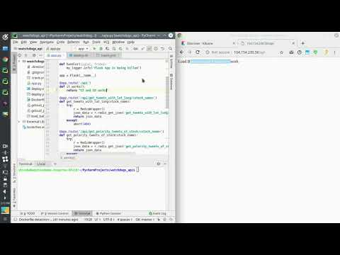

Slide 13

Front End
Dash Python Framework for building our Web Application
Gathering JSON data from our API call
Using Twitter data to create graphs
Deployed Dash Apps to web server and embedded them in our site
Notes:
Pandas DataFrame

Slide 14
Frontend Demo

Slide 15
Challenges
Trying to maximize limitations of Twitters free API.
Encrypting the API keys and using them in CI/CD
Debugging applications spread across different microservices
Learning how to use as many big data tools as possible
Tuning kafka and spark for better performance
Notes:
Krishna:
We tried to implement as many big data tools as possible
Encrypting the API keys and using them in CI/CD
Making API keys for each user who wants to access our developed API
Using webhooks to trigger the Travis build of other repositories if a different repo is updated.
-----------------------

Slide 16
What We Learned
Notes:
Krishna
CI and CD along with integrations of 9 big data tools.

